Slide 1


Nirbhay
Oct 8

Slide 2

Outline
Executive Summary
Introduction
Methodology
Results
Conclusion
Appendix

Slide 3
Executive Summary
Summary of methodologies
- Data collection using API
- Data wrangling
- Data visualization for exploration
-Data analysis with SQL and Python
- Model building with ML
Summary of all results
- Results of launch success over time
- Model prediction perform well

Slide 4
Introduction
Project background and context
-SpaceX's reusable rocket stages, especially the Falcon 9, have drastically cut the cost of space missions by enabling multiple launches with the same rocket stage. However, accurately predicting when a stage can be reused without costly refurbishment remains a challenge due to various mission-specific factors.
Problems we want to solve
-Prediction of Reusability
-Launch Cost Optimization
-Effect of Mission-specific Factors

Slide 5

Section 1

Slide 6
Methodology
Executive Summary
Data collection methodology:
Describe how data was collected
Perform data wrangling
Describe how data was processed
Perform exploratory data analysis (EDA) using visualization and SQL
Perform interactive visual analytics using Folium and Plotly Dash
Perform predictive analysis using classification models
How to build, tune, evaluate classification models

Slide 7
Data Collection
In this project, data was collected from the SpaceX REST API and additional web scraping. The API provided detailed information on rocket launches, including the rocket used, payload delivered, launch and landing specifications, and landing outcomes. The endpoint api.spacexdata.com/v4/launches/past was used to gather data on past launches, which was then processed into a structured format using Python libraries such as requests and json_normalize. Additionally, data was scraped from Wiki pages using BeautifulSoup for further analysis. Issues like null values in PayloadMass were handled by calculating and replacing missing data with the mean.

Slide 8
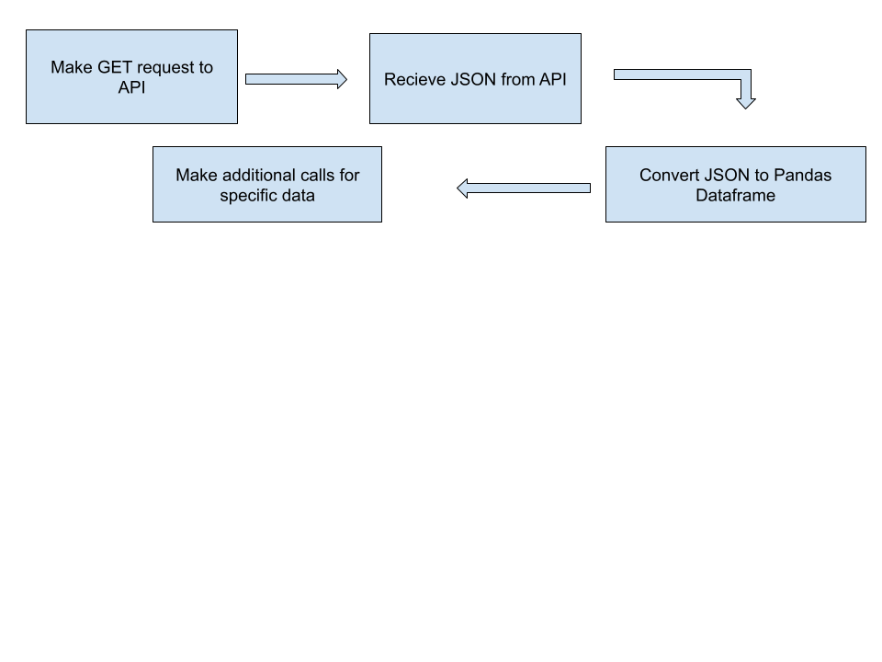
Data Collection – SpaceX API
Data was collected from the SpaceX REST API by targeting the /v4/launches/past endpoint. A GET request was used to retrieve JSON data on past launches. This data was then converted into a Pandas DataFrame using the json_normalize function for further analysis. Additional API calls were made to gather specific details, such as rocket and payload information.
https://github.com/Barracuda108/Data-Science-Capstone/blob/293a7ea5888c1b0c3df1fea2453802958520b82b/1-jupyter-labs-spacex-data-collection-api.ipynb

Slide 9
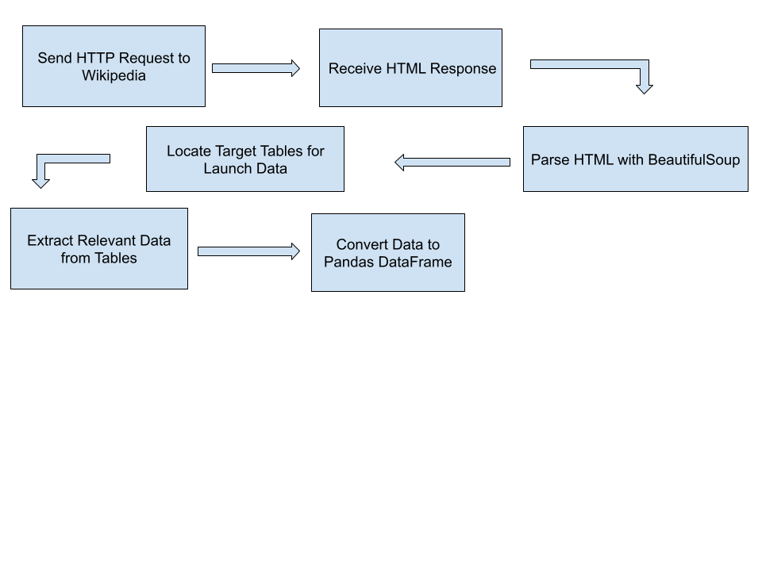
Data Collection - Scraping
Web scraping was conducted using the BeautifulSoup library to extract Falcon 9 launch data from relevant Wikipedia tables. The HTML content was parsed to locate and retrieve valuable launch records. This data was then organized and converted into a Pandas DataFrame for further analysis. Web scraping complemented the API data collection by providing additional context and details on Falcon 9 launches.
https://github.com/Barracuda108/Data-Science-Capstone/blob/293a7ea5888c1b0c3df1fea2453802958520b82b/2-jupyter-labs-webscraping.ipynb

Slide 10
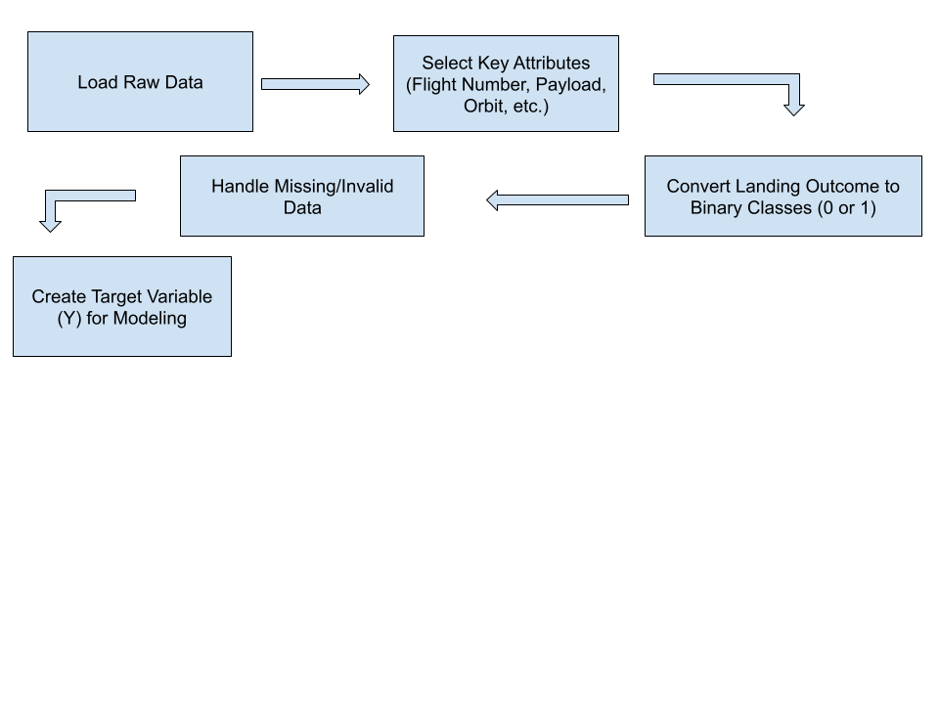
Data Wrangling
Key attributes like Flight Number, Booster Version, Payload Mass, Orbit, and Launch Site were processed. Landing Outcomes were converted into binary classes: 1 for successful landings and 0 for failures, creating the target variable (Y) for modeling.
https://github.com/Barracuda108/
Data-Science-Capstone/blob/293a7ea5888c1b0
c3df1fea2453802958520b82b/3-jupyter-labs-spacex
-Data%20wrangling.ipynb

Slide 11
EDA with Data Visualization
Visualize the launch success yearly trend with a line chart
FlightNumber vs. PayloadMass - scatter plot
Catplot to plot FlightNumber vs LaunchSite - category plot
Launch sites and their payload mass- category plot
Relationship between success rate and orbit type - bar plot
FlightNumber and Orbit type - category plot
Payload Mass and Orbit - category plot
https://github.com/Barracuda108/Data-Science-Capstone/blob/293a7ea5888c1b0c3df1fea2453802958520b82b/5-edadataviz.ipynb

Slide 12
EDA with SQL
Display the names of the unique launch sites in the space mission
Display 5 records where launch sites begin with the string 'CCA
Display the total payload mass carried by boosters launched by NASA (CRS)
Display average payload mass carried by booster version F9 v1.1
List the date when the first succesful landing outcome in ground pad was acheived.
List the names of the boosters which have success in drone ship and have payload mass greater than 4000 but less than 6000
List the total number of successful and failure mission outcomes
List the names of the booster_versions which have carried the maximum payload mass. Use a subquery
List the records which will display the month names, failure landing_outcomes in drone ship ,booster versions, launch_site for the months in year 2015.
Rank the count of landing outcomes (such as Failure (drone ship) or Success (ground pad)) between the date 2010-06-04 and 2017-03-20, in descending order.
https://github.com/Barracuda108/Data-Science-Capstone/blob/293a7ea5888c1b0c3df1fea2453802958520b82b/4-jupyter-labs-eda-sql-coursera_sqllite.ipynb

Slide 13
Build an Interactive Map with Folium
Mark all launch sites on a map using markers
Mark the success/failed launches for each site on the map using circles and markers
Calculate the distances between a launch site to its proximities using lines
These objects were added to the map to visually analyze launch site locations, outcomes, and proximities, providing insights into patterns that can help identify optimal launch sites.
https://github.com/Barracuda108/Data-Science-Capstone/blob/293a7ea5888c1b0c3df1fea2453802958520b82b/6-lab_jupyter_launch_site_location.ipynb

Slide 14
Build a Dashboard with Plotly Dash
Dropdown for Launch Site Selection:
Added a dropdown menu to select from different launch sites or view all sites.
Why: To allow users to filter data by launch site and view specific success rates for each site.
Success Rate Pie Chart:
A pie chart that shows the number of successful and failed launches.
Why: To give a quick visual representation of the success rate for selected launch sites.
Range Slider for Payload Mass:
A range slider for selecting a payload mass range (0 to 10,000 kg).
Why: To explore the correlation between payload mass and launch success, letting users filter based on payload.
Scatter Plot for Payload vs. Success:
A scatter plot that shows the relationship between payload mass and launch success, with color-coded booster versions.
Why: To visually identify how payload mass and booster version affect launch outcomes, helping in deeper analysis.
These plots and interactions were added to allow users to explore relationships between launch site, payload mass, and success rate, facilitating data-driven insights into SpaceX launches.
https://github.com/Barracuda108/Data-Science-Capstone/blob/293a7ea5888c1b0c3df1fea2453802958520b82b/7-spacex_dash_app.py

Slide 15
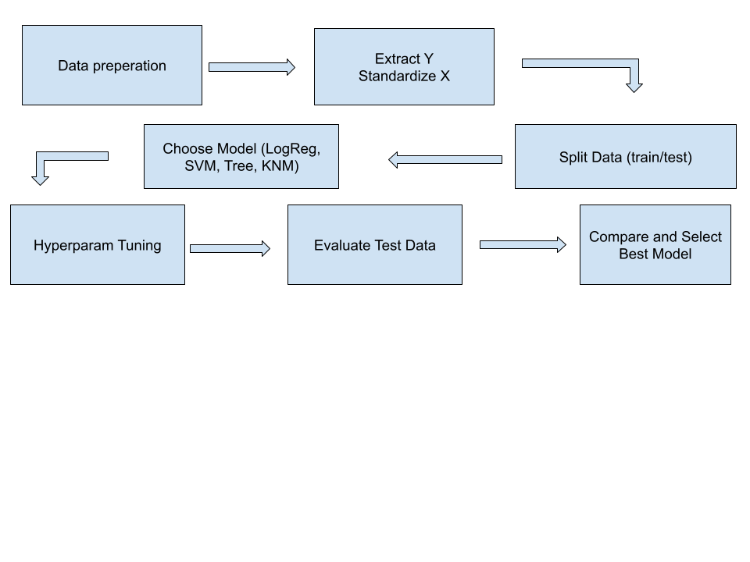
Predictive Analysis (Classification)
The model development process involved creating the target variable, standardizing the data, and splitting it into training and testing sets. Logistic Regression, SVM, Decision Trees, and KNN models were trained and optimized using GridSearchCV with 10-fold cross-validation. Each model was evaluated for accuracy on the test data, and the best-performing model was selected based on the highest accuracy and lowest error rate.
https://github.com/Barracuda108/Data-Science-Capstone/blob/293a7ea5888c1b0c3df1fea2453802958520b82b/8-SpaceX_Machine%20Learning%20Prediction_Part_5.ipynb

Slide 16
Results
Exploratory data analysis results
Interactive analytics demo in screenshots
Predictive analysis results

Slide 17

Section 2

Slide 18
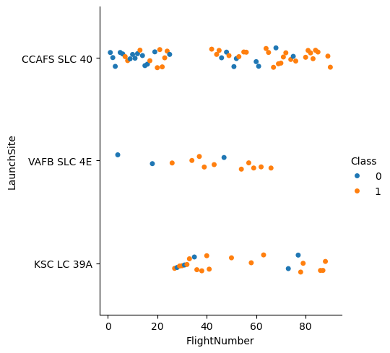
Flight Number vs. Launch Site
Show the screenshot of the scatter plot with explanations

Slide 19
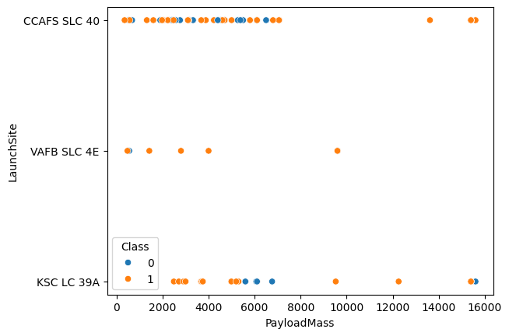
Payload vs. Launch Site
Show a scatter plot of Payload vs. Launch Site
Show the screenshot of the scatter plot with explanations

Slide 20
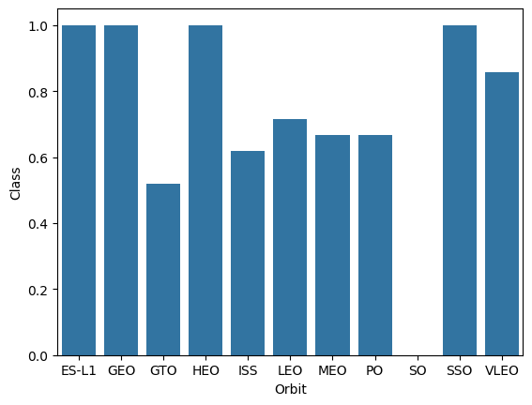
Success Rate vs. Orbit Type
Show a bar chart for the success rate of each orbit type
Show the screenshot of the scatter plot with explanations

Slide 21
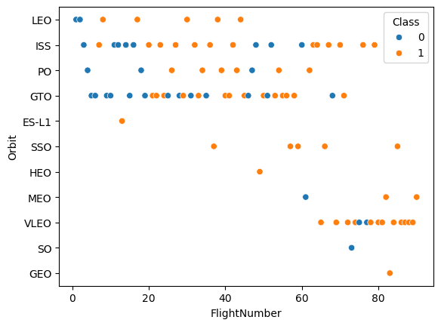
Flight Number vs. Orbit Type
Show a scatter point of Flight number vs. Orbit type
Show the screenshot of the scatter plot with explanations

Slide 22
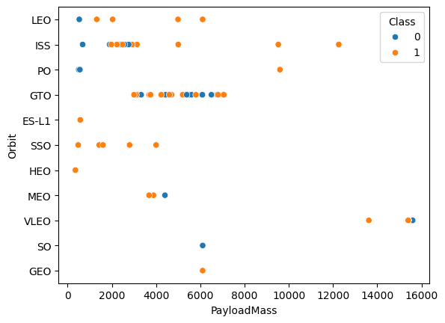
Payload vs. Orbit Type
Show a scatter point of payload vs. orbit type
Show the screenshot of the scatter plot with explanations

Slide 23
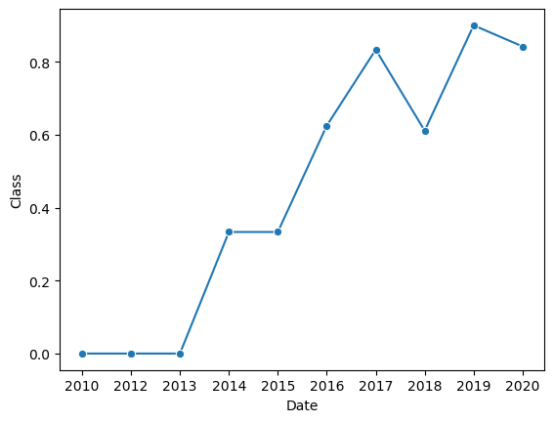
Launch Success Yearly Trend
Show a line chart of yearly average success rate
Show the screenshot of the scatter plot with explanations

Slide 24
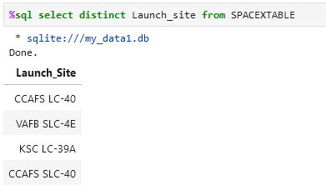
All Launch Site Names
The figure shows a list of all launch sites names

Slide 25
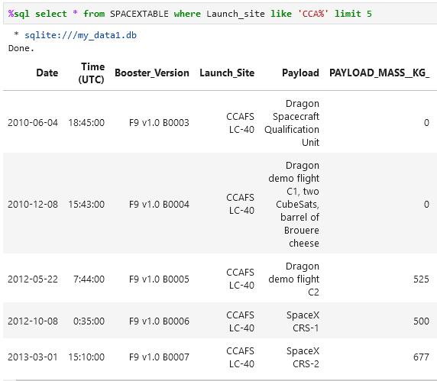
Launch Site Names Begin with 'CCA'
Here are 5 records where launch sites begin with `CCA`

Slide 26
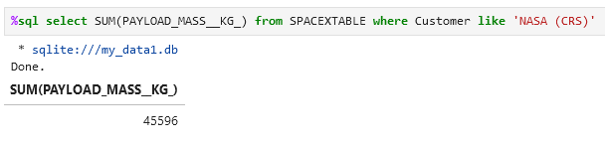
Total Payload Mass
the total payload carried by boosters from NASA

Slide 27
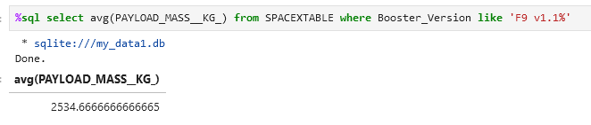
Average Payload Mass by F9 v1.1
The average payload mass carried by booster version F9 v1.1

Slide 28
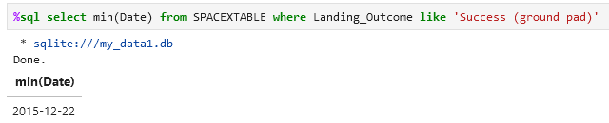
First Successful Ground Landing Date
Dates of the first successful landing outcome on ground pad

Slide 29
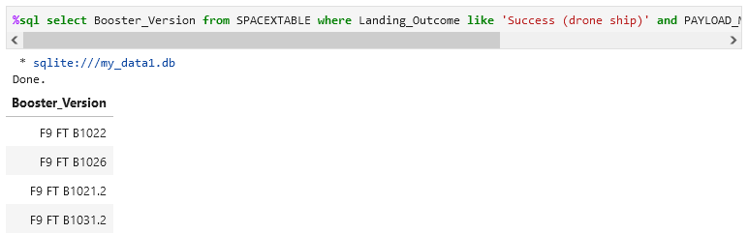
Successful Drone Ship Landing with Payload between 4000 and 6000
Names of boosters which have successfully landed on drone ship and had payload mass greater than 4000 but less than 6000

Slide 30
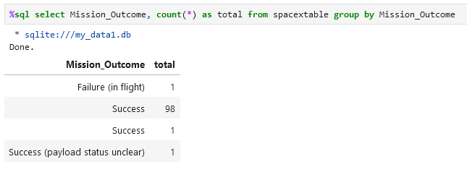
Total Number of Successful and Failure Mission Outcomes
Total number of successful and failure mission outcomes

Slide 31
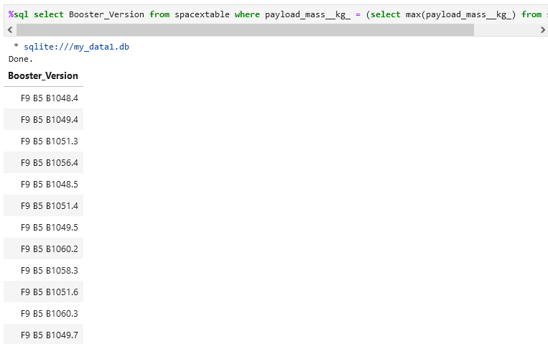
Boosters Carried Maximum Payload
Names of the booster which have carried the maximum payload mass

Slide 32
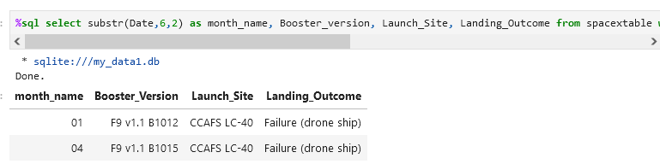
2015 Launch Records
Failed landing_outcomes in drone ship, their booster versions, and launch site names for in year 2015

Slide 33
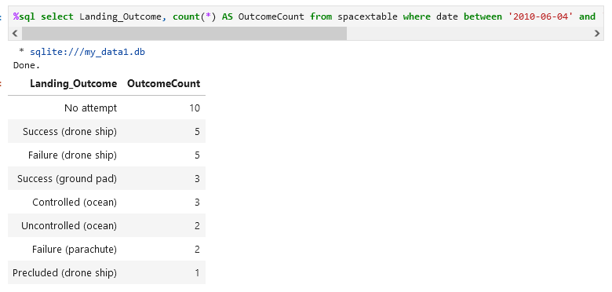
Rank Landing Outcomes Between 2010-06-04 and 2017-03-20
Rount of landing outcomes (such as Failure (drone ship) or Success (ground pad)) between the date 2010-06-04 and 2017-03-20, in descending order

Slide 34

Section 3

Slide 35
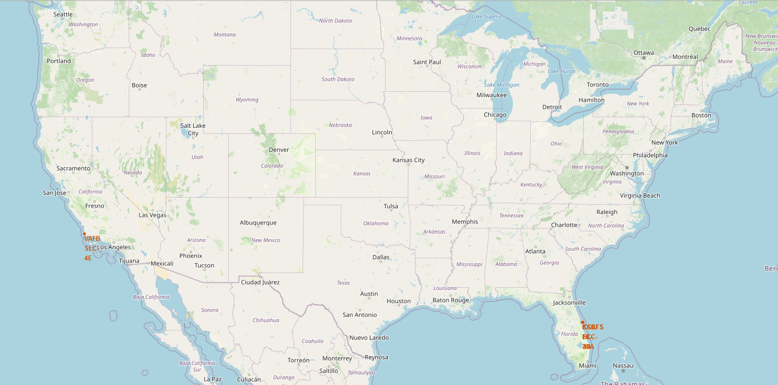
Map of Launch Sites
Launch Sites in US

Slide 36
<Folium Map Screenshot 2>
Replace <Folium map screenshot 2> title with an appropriate title
Explore the folium map and make a proper screenshot to show the color-labeled launch outcomes on the map
Explain the important elements and findings on the screenshot

Slide 37
<Folium Map Screenshot 3>
Replace <Folium map screenshot 3> title with an appropriate title
Explore the generated folium map and show the screenshot of a selected launch site to its proximities such as railway, highway, coastline, with distance calculated and displayed
Explain the important elements and findings on the screenshot

Slide 38

Section 4

Slide 39
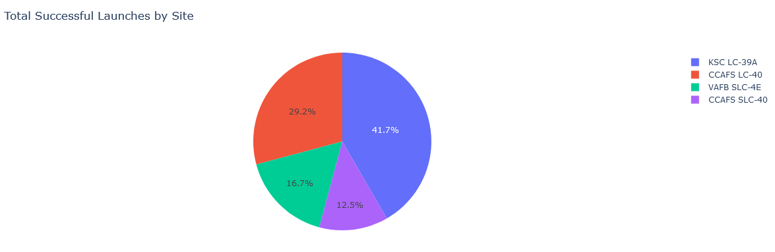
Launch success for all Sites
Shows the success proportion of all the sites

Slide 40
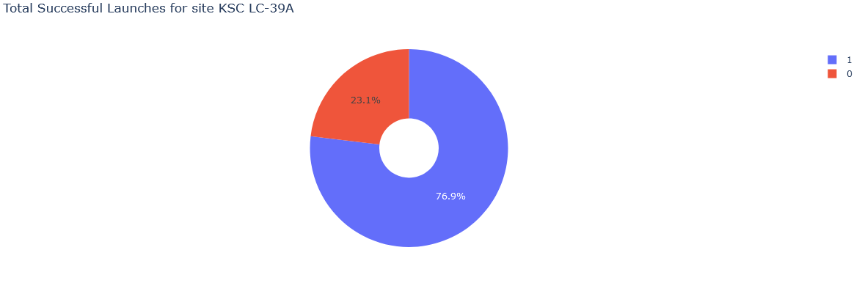
Site with highest success rate
Launch site with highest launch success ratio

Slide 41
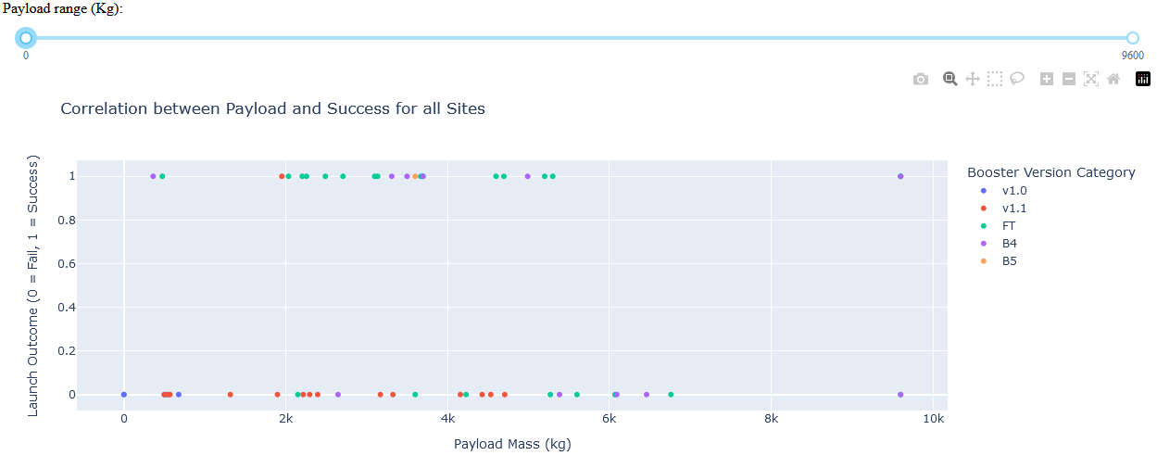
Payload vs. Launch Outcome
Payload vs. Launch Outcome scatter plot for all sites, with different payload selected in the range slider

Slide 42

Section 5

Slide 43
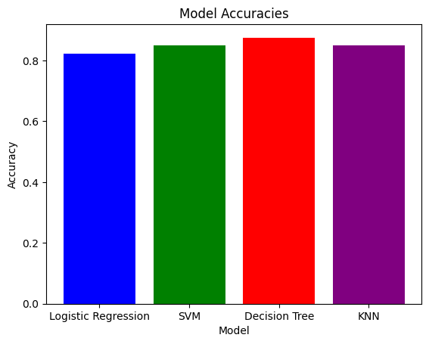
Classification Accuracy
We see that Decision Tree has the best accuracy for prediction model in this case

Slide 44

Confusion Matrix
The confusion matrix for decision tree
We see it is less prone to false classifications than other models

Slide 45
Conclusions
We were able to determine cost efficiency of launces based on various factors. Ksc launch site has greater success and so do GEO and HEO orbit launches
We are able to see if Space X will reuse their first stages as they increase with time
We can use decision tree model to determine success of first stage
…

Slide 46
Appendix
https://github.com/Barracuda108/Data-Science-Capstone.git

Slide 47


